Slide 1
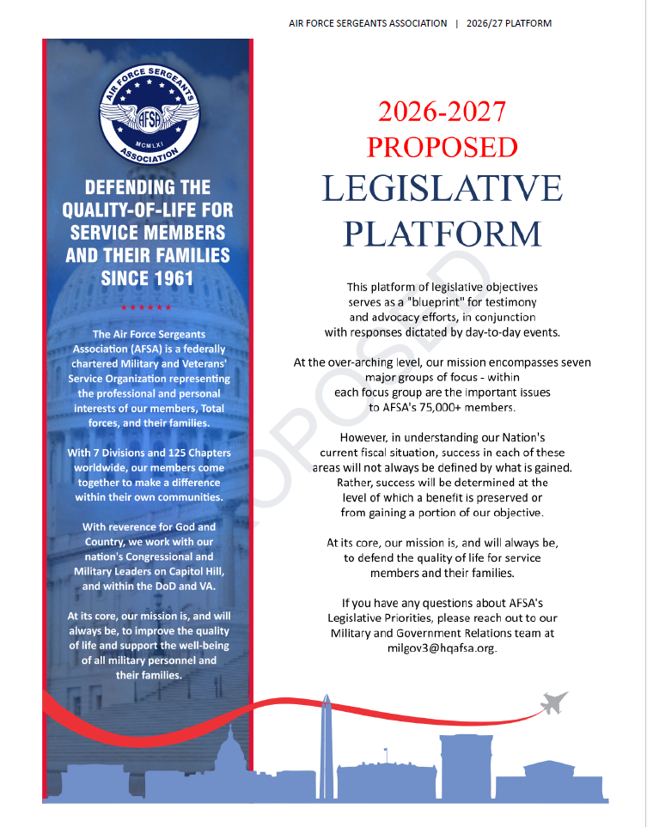

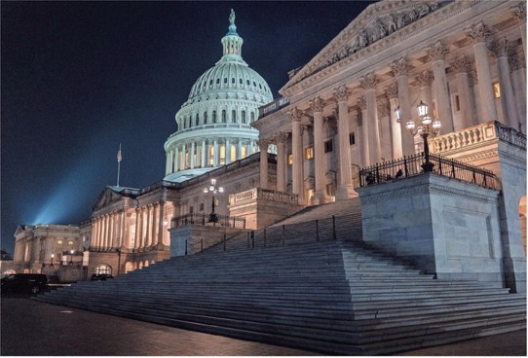

PLATFORM PROCESS
CHAPTERS SERVE AS “EYES AND EARS” ON BENEFIT MATTERS;
CHAPTERS/DIVISIONS INPUT TO AFSA HQ AND THE INTERNA- TIONAL LEGISLATIVE COMMITTEE (ILC) DURING THE YEAR;
(NOV-DEC) MEMBERS PARTICIPATE IN SURVEYS;
(JAN-FEB) ILC AND AFSA HQ DRAFT A PROPOSED PLATFORM (A
LEGISLATIVE TARGET LIST) FOR THE UPCOMING FISCAL YEAR;
(MARCH) INTERNATIONAL BOARD OF DIRECTORS OKAYS PROPOSED PLATFORM TO PRESENT TO THE AFSA GENERAL MEMBERSHIP FOR RATIFICATION AT THE INT’L CONVENTION;
(JUL OR AUG) AFSA MEMBERS RATIFY THE NEW PLATFORM; IT TAKES EFFECT AT THE END OF THAT CONVENTION.
LOBBYING
NEW
PLATFORM TARGETS
LEGISLATION
TESTIFYING
GRASSROOTS
LAWS

Slide 2
KEY ITEMS IN PROPOSED 2026-2027 PLATFORM
MILITARY PAY, BENEFITS, & PROGRAMS
PROTECT AND STRENGTHEN MILITARY PAY, BAH, COLA, SPECIAL PAYS, LEAVE
POLICIES, COMMISSARIES, EXCHANGES, AND MWR PROGRAMS;
EXPAND BEREAVEMENT LEAVE AND ALLOW LEAVE TRANSFERABILITY;
STRENGTHEN OVERSIGHT AND ENFORCEMENT OF MILITARY HOUSING QUALITY.
VETERAN & RETIREE HEALTHCARE AND BENEFITS
IMPROVE VA HEALTHCARE ACCESS/QUALITY, REDUCE CLAIMS BACKLOGS;
EXTEND CONCURRENT RECEIPT TO ALL DISABLED RETIREES;
SUPPORT FULL IMPLEMENTATION OF PACT ACT, HYPERBARIC OXYGEN THERAPY, AND
SUICIDE PREVENTION PROGRAMS;
ENSURE WOMEN VETERANS AFFORDED HIGH-QUALITY, GENDER-SPECIFIC CARE.

Slide 3
MILITARY HEALTHCARE
PROTECT TRICARE; OPPOSE FEE INCREASES FOR HEALTHCARE AND PHARMACY;
OPPOSE REDUCTION OF MILITARY BILLETS LEADING TO LOSS OF ACCESS OR
SHIFTING COSTS ONTO FAMILY MEMBERS;
PRETAX PAYMENT OF HEALTH, DENTAL, AND LONG-TERM CARE PREMIUMS;
INCLUDE AIR RESERVE TECHNICIANS’ TRICARE RESERVE SELECT ELIGIBILITY.
MILITARY FAMILIES
EXPAND AFFORABLE, HIGH-QUALITY CHILDCARE ACCESS ALIGNED WITH
OPERATIONAL REALITIES;
STRENGTHEN MILITARY SPOUSE EMPLOYMENT PROGRAMS, AND ELIMINATE
PCS-DRIVEN LICENSURE BARRIERS.

Slide 4
EDUCATION
FULLY FUND MilTA, MyCAA, & GI BILL PROGRAMS; PROTECT BENEFIT TRANSFERABILITY;
ENSURE TUITION ASSISTANCE FOR ALL COMPONENTS OF THE TOTAL FORCE;
IMPROVE CREDIT TRANSFER AND PRIOR LEARNING RECOGNITION TO REDUCE
TIME-TO-DEGREE AND COST;
STRENGTHEN TRANSITION PROGRAMS.
CARING FOR SURVIVORS
ALLOW SURVIVING SPOUSES TO RECEIVE FINAL FULL MONTH OF RETIRED PAY;
PROTECT VALUE OF SURVIVOR BENEFIT PROGRAMS.

Slide 5
GUARD & RESERVE BENEFITS
CREDIT ALL POST-9/11 ACTIVE-DUTY SERVICE TOWARD EARLY RETIREMENT;
REDUCE RETIREMENT AGE AND REMOVE CAP ON CREDITABLE INACTIVE DUTY POINTS;
EXPAND EDUCATION BENEFITS FOR GUARD MEMBERS & DUAL-STATUS TECHNICIANS.
REFORM DUTY STATUS AUTHORITIES TO ENSURE COMPENSATION, BENEFITS, AND
PROTECTIONS MATCH SERVICE PERFORMED.

Slide 6
KEY DATES
2026 POW/MIA RECOGNITION DAY/WEEK
FRIDAY, 18 SEPTEMBER / 13-19 SEPTEMBER
2026 AFSA LEGISLATIVE AWARENESS WEEK
18-24 OCTOBER

